Slide 1
Occupational Specialist Component Content: Digital Production, Design and Development
The T Level T Level Technical Qualification in Digital: Digital Production, Design and Development includes a single Occupational Specialist Component. Therefore, there is a single synoptic assessment for the Occupational Specialist Component, which is an extended ‘design, development and implementation’ project. The synoptic element of the project is important in order to ensure that students are able to demonstrate threshold competence: this is the principal reason why the Occupational Specialism is assessed via a single extended project assessment to ensure that students are able to evidence all the skills required by the Performance Outcomes.
The T Level Technical Qualification in Digital: Digital Production, Design and Development Occupational Specialist Component consists of several activities grouped into four substantive tasks.
Each task will be completed during a window set by Pearson during which you will schedule supervised assessment sessions. In some cases, tasks will also involve opportunities for unsupervised activities where the requirements of the skills being assessed make this necessary.

Slide 2
The unit outcomes
1.3 Understand the key features of, and be able to select, appropriate project methodologies when developing a software solution
Key features of Agile
Key features of Scaled Agile
Key features of waterfall
Key features of Rapid Application Development (RAD)
Key Features of LEAN
Notes:
Key features of Agile:
● incremental delivery models:
o sprint
o epic
o story
o spikes.
● emphasis on producing high-quality producing products with initially
limited functionality.
● each increment delivers additional functionality.
● requirements can be continually altered throughout the project.
● can lack formal documentation.
● users/clients see working products at each iteration.
● cost effective method to get an initial product to market.
● cancelled/partially completed projects will have still resulted in some
useable code/product(s).
altered throughout the project.
● provides cohesive reporting.
● users/clients see working products at each iteration.
● cost effective method to get an initial product to market.
● cancelled/partially completed projects will have still resulted in some
useable code/product(s).
● final iteration focuses on stability.
Key features of waterfall:
● rigidly structured with systematic steps.
● progress measured through the number of artefacts completed.
● high initial costs with slower return on investment.
● products cancelled during early stages may result in no useable
code/product(s).
● limited user/client interaction.
● high importance placed on documentation.
Key features of Rapid Application Development (RAD):
● focus on quick creation of prototypes which are systematically improved
● emphasis on developing all features first and quality second
● users/clients may see only partially working products or mockups during
early iterations
● relies heavily on reuse of previously developed code
● suitable for small to medium scale projects
Key Features of LEAN:
● emphasis on reducing ‘waste’ in software (and projects) which may
include:
o unnecessary or incorrect features
o repeated tasks
o unnecessarily complex solutions
o ineffective communication
o unnecessary changes.
● decisions are made last minute to reduce chance of waste.
● short iteration cycles with fast delivery of working versions.
● emphasis placed on producing iterations that are fit for use and not
specifically in delivering all features or requirements.
● suitable for projects with small teams and when resources are limited.
● understand features and approaches of User Centered Design (UCD)
and how it is used within a software development lifecycle:
o considerations for UCD:
– Who is the user?
– What does the user want to achieve by using the product?
– How does the user interact with the product?
– When does the user interact with the product?
– Why is the product being used?
– What is the user experience?
o Characteristics of UCD (empathetic, iterative, interdisciplinary)
o Stages of the UCD iterative approach:
– understand the use context
– specify the user requirements
– design the solution
– assess against requirements.

Slide 3
Learning Objectives
Aims:
To introduce the key features of, and be able to select, appropriate project methodologies when developing a software solution
Objectives:
To be able to :
Understand key characteristics of major development methodologies
Evaluate when to use each approach
Recognize advantages such as iterative delivery and cost-effectiveness
Explore user-centred design (UCD) in the development lifecycle

Slide 4
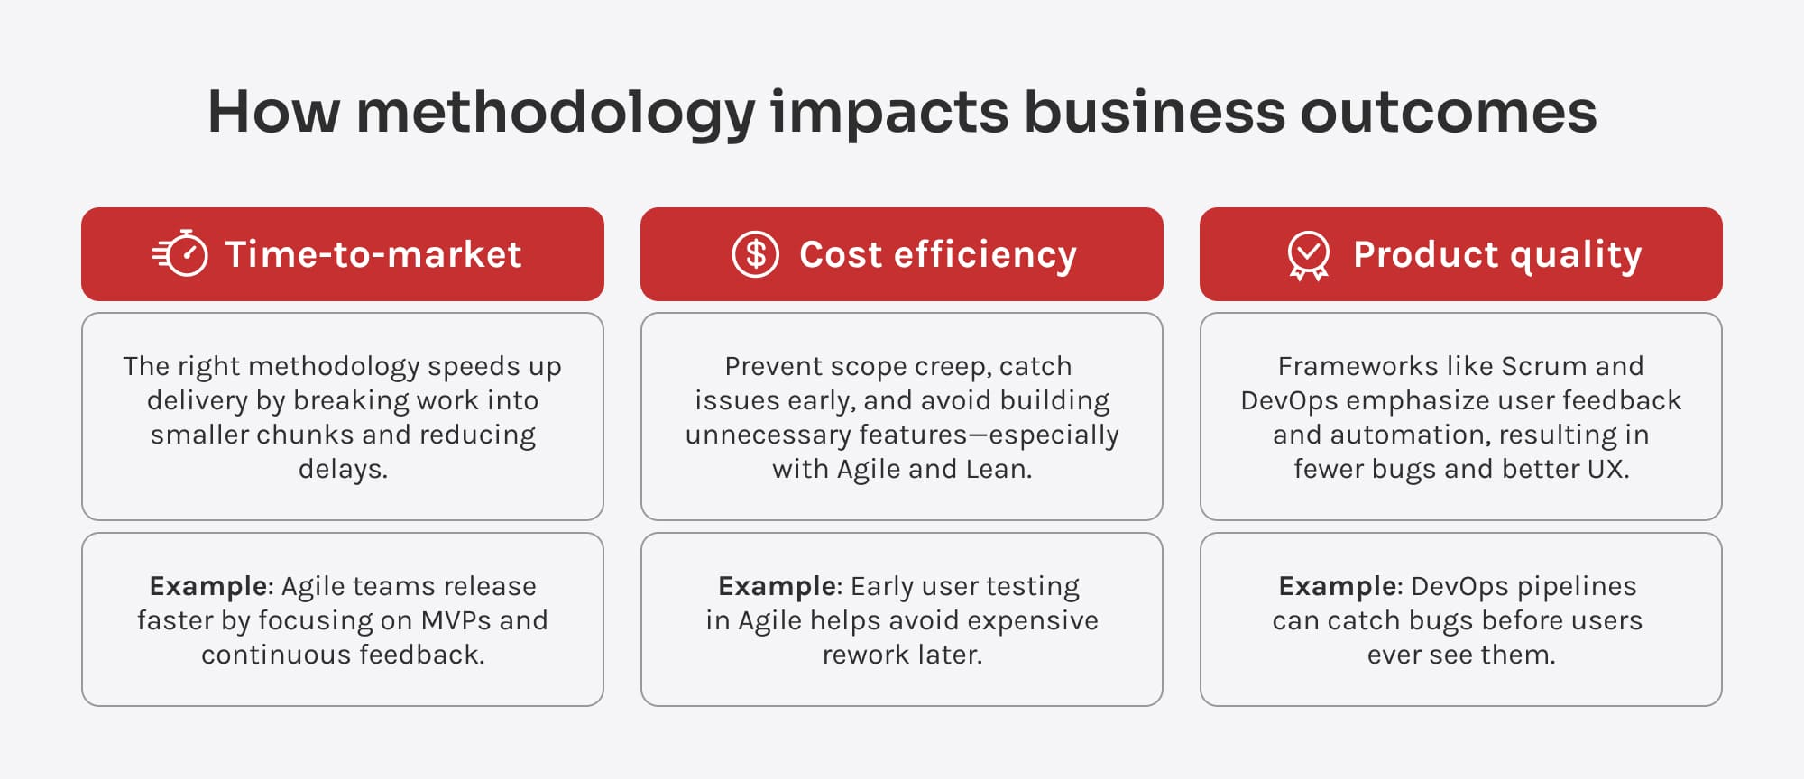
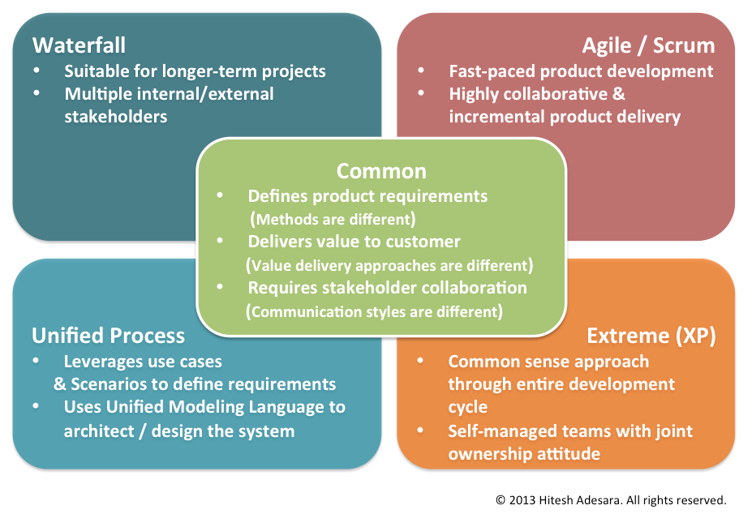
Why Methodology Matters
Before the start of a software development project a decision has to be made on which software development methodology should be used.
This management decision will:
Shapes how software is built and delivered
Influences team structure, time, budget, and client involvement
Determines how well a project can adapt to change
Helps ensure projects are on time, within budget, and meet user needs
Notes:
https://pmoexcellence.blog/2013/04/28/software-development-methodologies-i/
https://innowise.com/blog/software-development-methodologies/

Slide 5
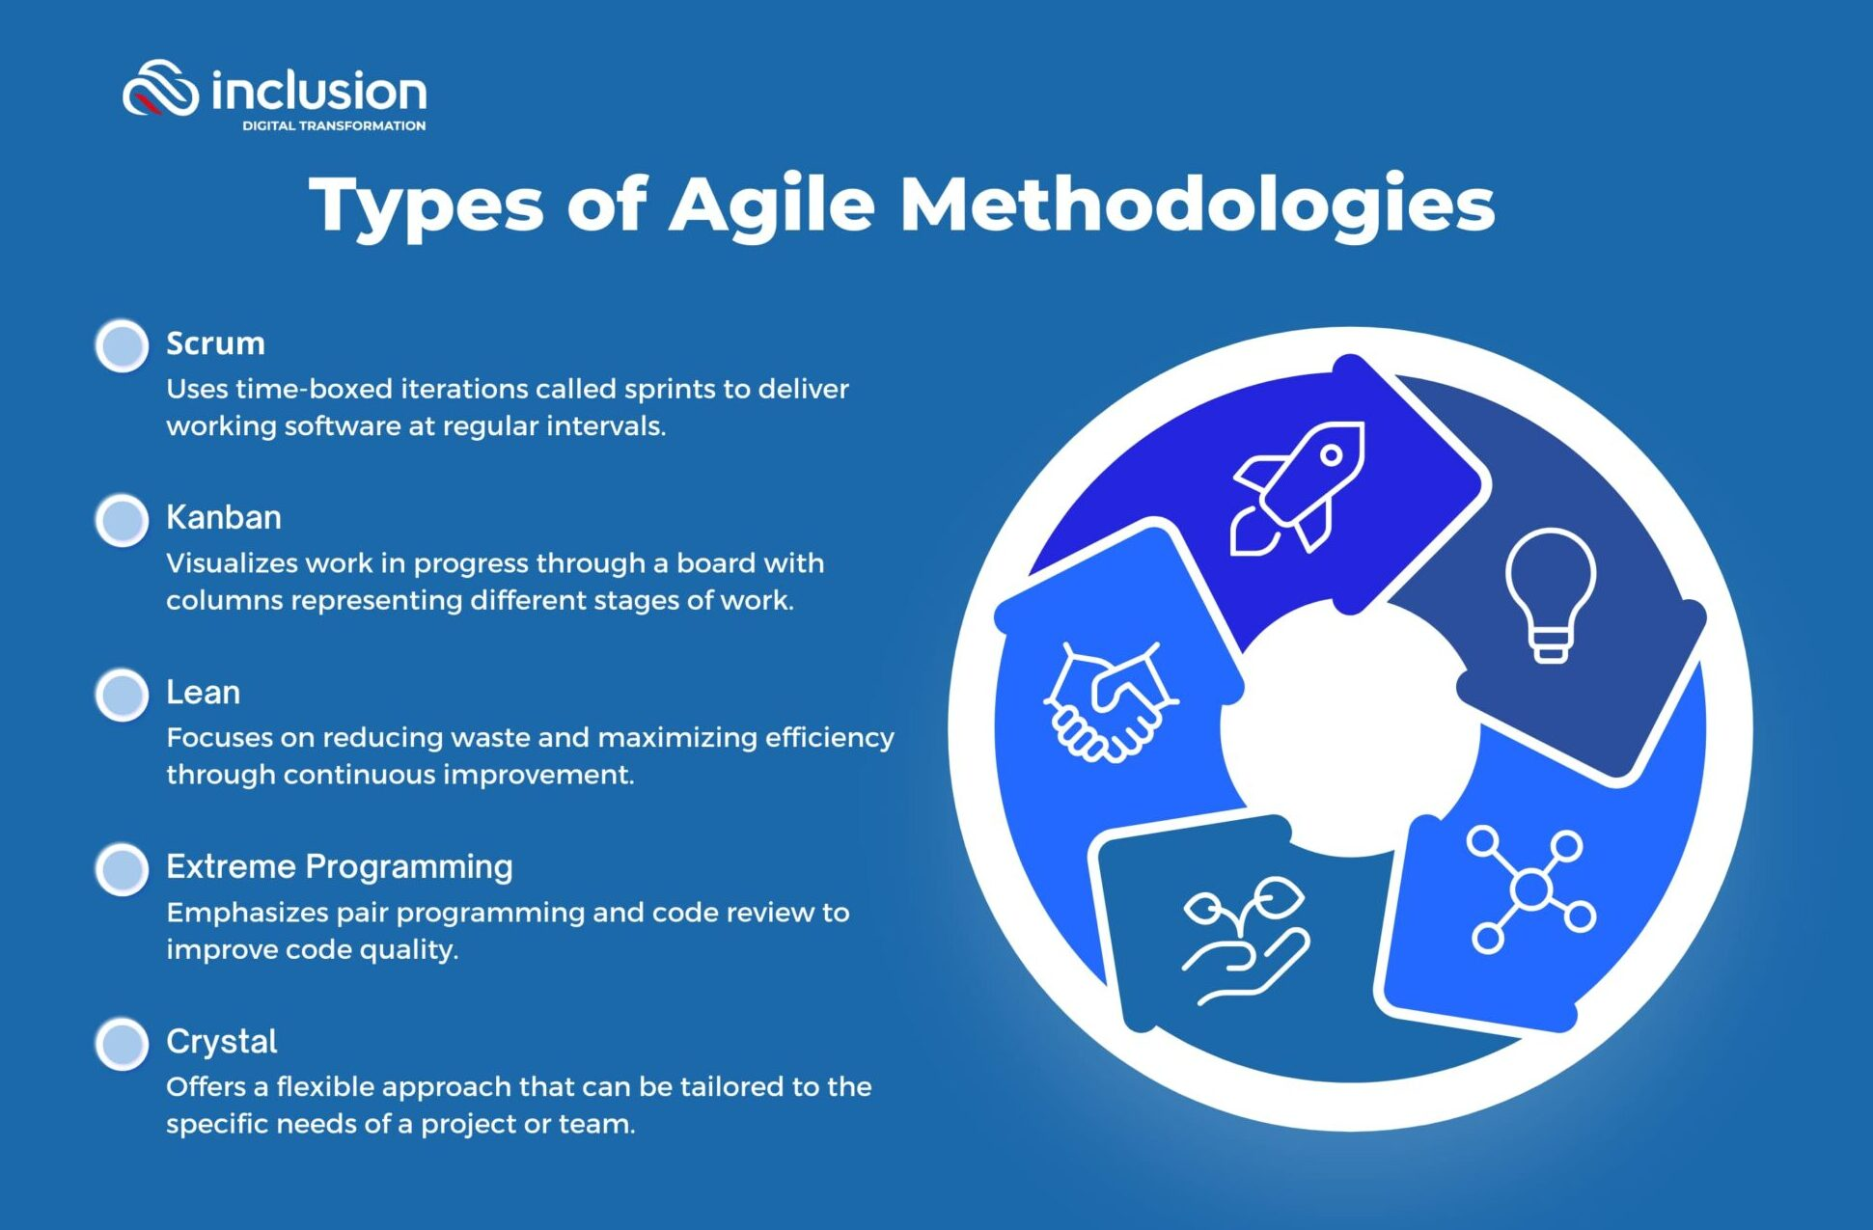
Agile
Agile is a flexible, collaborative software development methodology focused on delivering small, functional components quickly.
It promotes continuous user feedback, frequent releases, and the ability to adapt to change throughout the project.
Key Features:
Iterative and incremental development cycles (e.g., sprints)
Frequent delivery of working software
Prioritizes user involvement and feedback
Encourages face-to-face communication
Accepts changing requirements, even late in the project
Promotes team collaboration and self-organization
Best suited for:
Small to medium-sized teams
Projects where requirements evolve over time
Environments needing fast delivery and adaptability
Notes:
https://inclusioncloud.com/insights/blog/agile-methodologies-business/

Slide 6
Types of Agile Development
Agile is an umbrella term for several lightweight, flexible methodologies that promote iterative development, collaboration, and customer feedback.
Here are the most commonly used types:
Scrum:
Most widely used Agile framework
Work is divided into time-boxed sprints (typically 2–4 weeks)
Defined roles: Scrum Master, Product Owner, Development Team
Emphasizes daily stand-ups, sprint reviews, and retrospectives
Best suited for:
Small to medium-sized teams
Projects where requirements evolve over time
Environments needing fast delivery and adaptability
Notes:
Scrum
Most widely used Agile framework
Work is divided into time-boxed sprints (typically 2–4 weeks)
Defined roles: Scrum Master, Product Owner, Development Team
Emphasizes daily stand-ups, sprint reviews, and retrospectives
🔄 Kanban
Visual management system using a Kanban board
Focuses on continuous delivery and workflow optimization
Limits work in progress (WIP limits) to avoid bottlenecks
No fixed time boxes; highly adaptable
🛠 Extreme Programming (XP)
Prioritizes technical excellence and customer satisfaction
Practices include Test-Driven Development (TDD), pair programming, and continuous integration
Frequent releases in short development cycles
🧩 Feature-Driven Development (FDD)
Combines Agile with model-driven engineering
Focuses on designing and building features (small, client-valued functions)
Best for larger teams and structured environments
⚙️ Crystal
Lightweight, people-centric methodology
Different "colors" (e.g., Crystal Clear, Crystal Orange) for different team sizes and project criticality
Prioritizes collaboration and adaptability

Slide 7
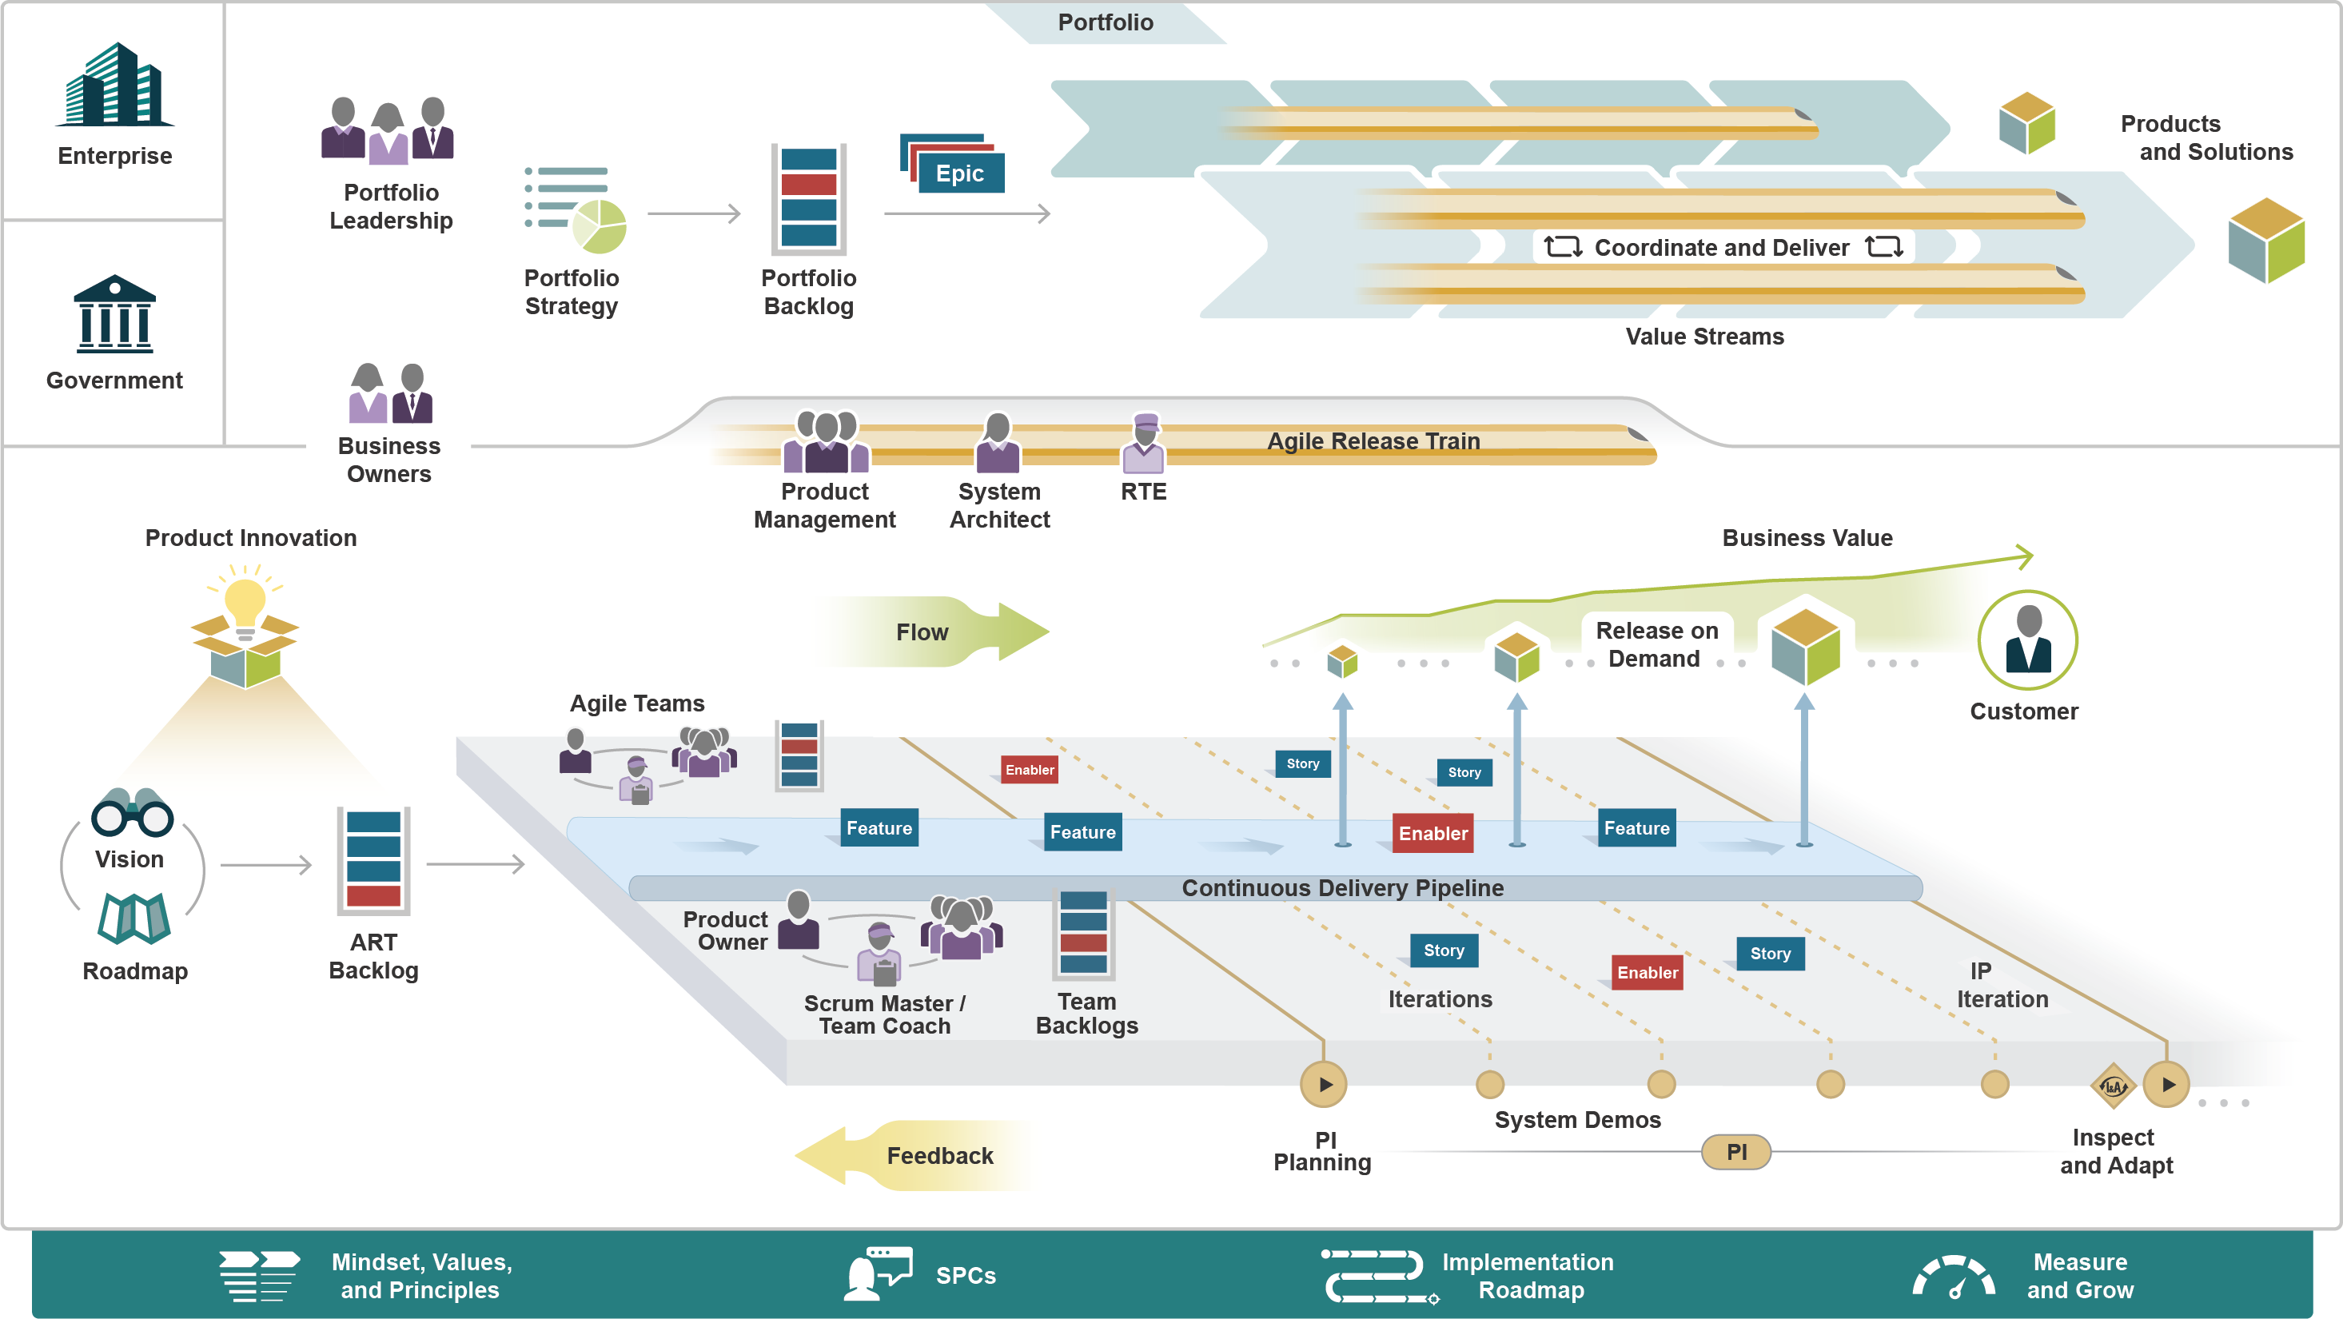
Scale Agile
Scaled Agile Framework (SAFe) is an agile methodology designed to apply agile principles to large-scale enterprise projects.
It promotes continuous delivery, fast feedback, and coordination across multiple teams.
Key Features:
Expanded incremental delivery using Sprint, Epic, Story, Spike, Product Increment.
Delivers high-quality products with limited initial functionality
Each increment adds new features
Requirements can change continually
Clients see working software regularly
Final iteration focuses on polishing and stability
Provides clear reporting and coordination tools
Benefits:
Early delivery of working software
Cost-effective market entry
Cancelled projects still yield useful components
Encourages collaboration, adaptation, and visibility
Ideal for large organizations with complex projects
Notes:
https://framework.scaledagile.com/

Slide 8
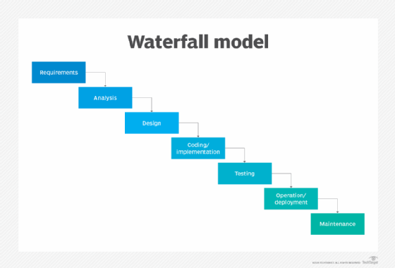
Waterfall
Waterfall is a linear and sequential methodology, where each phase (e.g., requirements, design, development) is completed before the next begins.
It is heavily documented and structured.
Key Features:
Strict, step-by-step progression
Emphasis on planning and documentation
Little client interaction after the initial stages
Progress measured by artefacts, not working code
High initial cost; slow returns
No usable product if cancelled early
Best Use Cases:
Early delivery of working software
Fixed requirements
Safety-critical systems (e.g., aerospace, banking)
Projects requiring full documentation and traceability
Poor fit for changing or unclear requirements
Notes:
https://www.techtarget.com/searchsoftwarequality/definition/waterfall-model

Slide 9
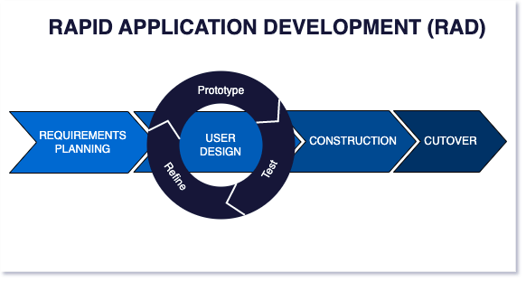
Rapid Application Development (RAD)
RAD emphasizes rapid prototyping and user feedback over strict planning.
It prioritizes building a functional system quickly, often by reusing components.
Pros & Cons:
Fast results and user feedback
Efficient for time-critical or well-scoped projects.
Lower initial quality.
Less structured; harder to manage at scale.
Key Features:
Focuses on speed and iteration
Users interact with mock-ups or partial systems
Quick feedback cycles
Heavy reuse of existing code/components
Prioritizes building features first, quality later
Best suited for smaller, time-sensitive projects
Notes:
https://www.agilelonestar.com/knowledge-base/rapid-application-development
https://kissflow.com/application-development/rad/rapid-application-development/

Slide 10
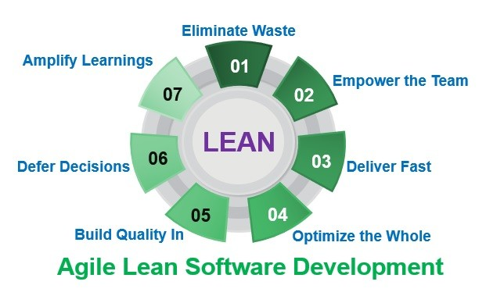
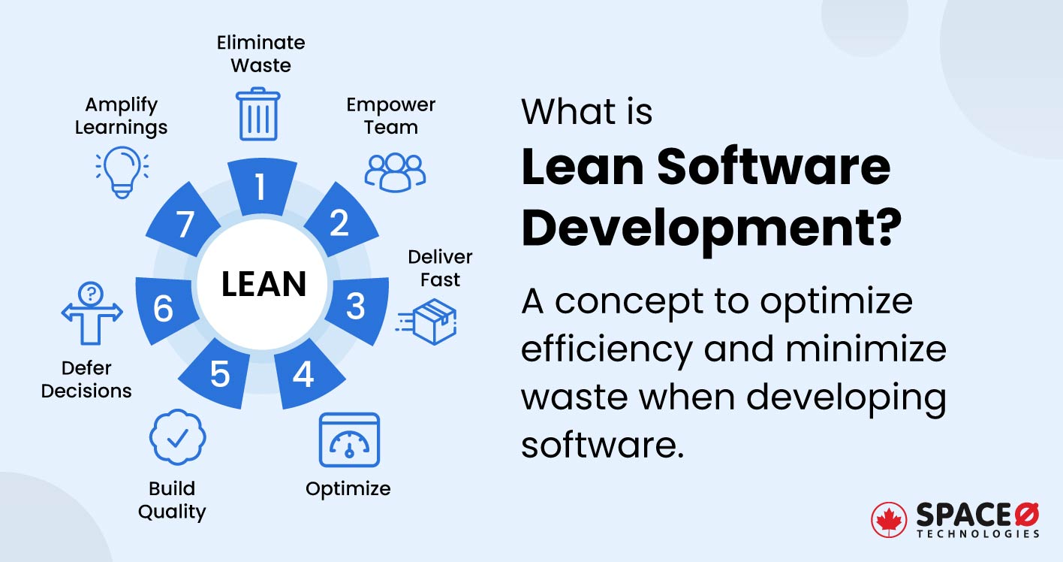
LEAN
LEAN development is based on manufacturing principles, focusing on maximizing value by eliminating waste in processes, code, and communication..
Suitable For:
Small teams/startups
Projects needing continuous delivery
Situations requiring agility and fast value delivery
Less suitable for rigid, heavily regulated projects
Key Features:
Identifies and removes waste:
Unneeded features, manual tasks, communication gaps
Delays decisions to avoid rework
Short, fast cycles with frequent, usable releases
Focused on functionality over feature completeness
Ideal for small teams or resource-constrained environments
Notes:
https://hangoutagile.com/lean-software-development-wave-ii/
https://www.spaceo.ca/glossary/software-terms/what-is-lean-software-development/

Slide 11
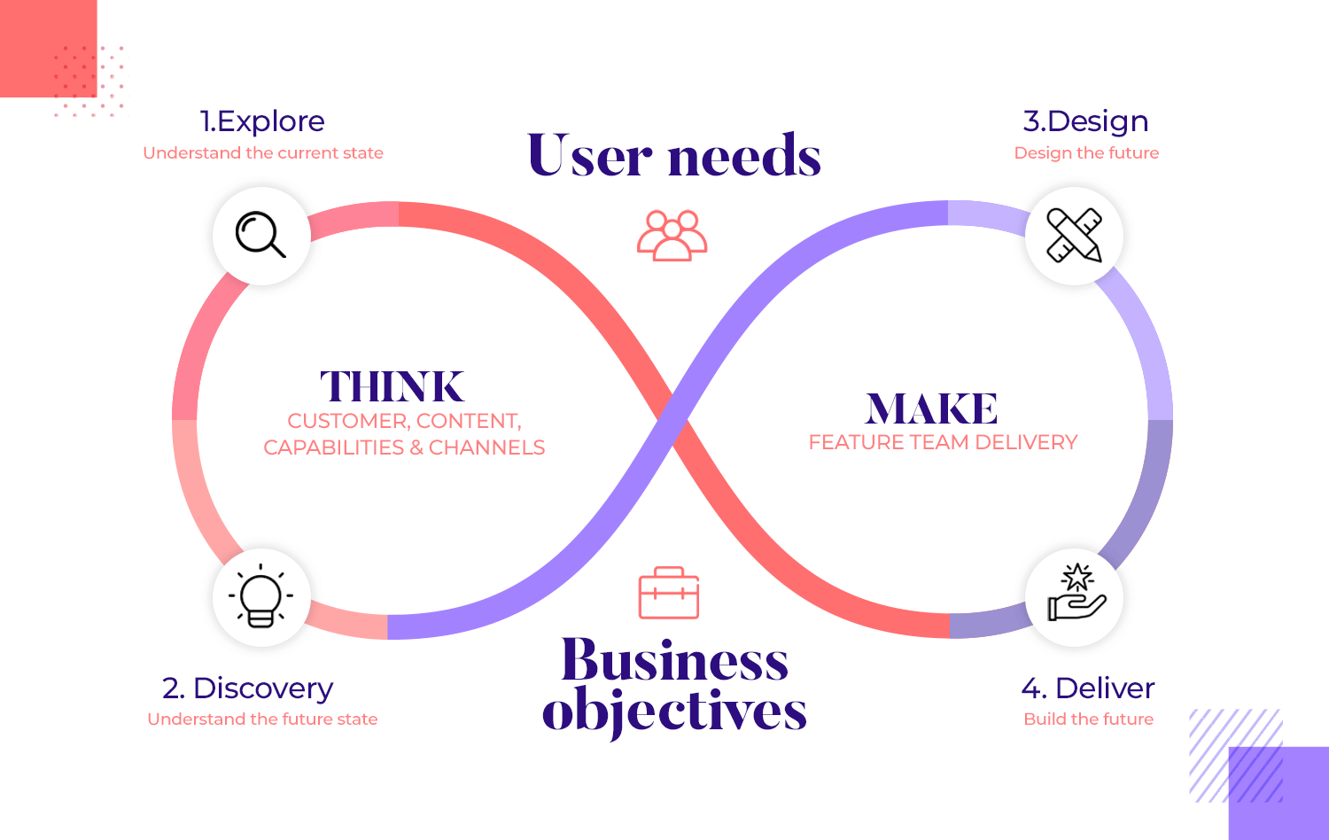
USER-CENTRED DESIGN (UCD)
UCD is an approach to software development that prioritizes the user's needs, goals, and experience throughout the lifecycle.
It’s iterative, empathetic, and involves feedback at every stage.
Key Considerations:
Who are the users?
What are their goals?
How do they use the product?
Why and when is it used?
What is the user experience like?
Stages:
Understand the context of use
Specify user requirements
Design the solution
Assess against requirements Repeat until user needs are met
Characteristics:
Empathetic
Iterative
Interdisciplinary
Notes:
https://www.justinmind.com/blog/user-centered-design/

Slide 12
Comparing Methodologies
Feature | Agile | Scaled Agile | Waterfall | RAD | LEAN
Iterative Development | ✅ | ✅ | ❌ | ✅ | ✅
Client/User Involvement | High | High | Low | Medium | Medium
Suitable for Changing Requirements | ✅ | ✅ | ❌ | ✅ | ✅
Fast Delivery of Working Products | ✅ | ✅ | ❌ | ✅ | ✅
Team Size | Small | Large/Enterprise | Medium to Large | Small to Medium | Small
Documentation Emphasis | Low | Medium | ✅ | Low | Low
Usable Output if Cancelled | ✅ | ✅ | ❌ | ✅ | ✅

Slide 13
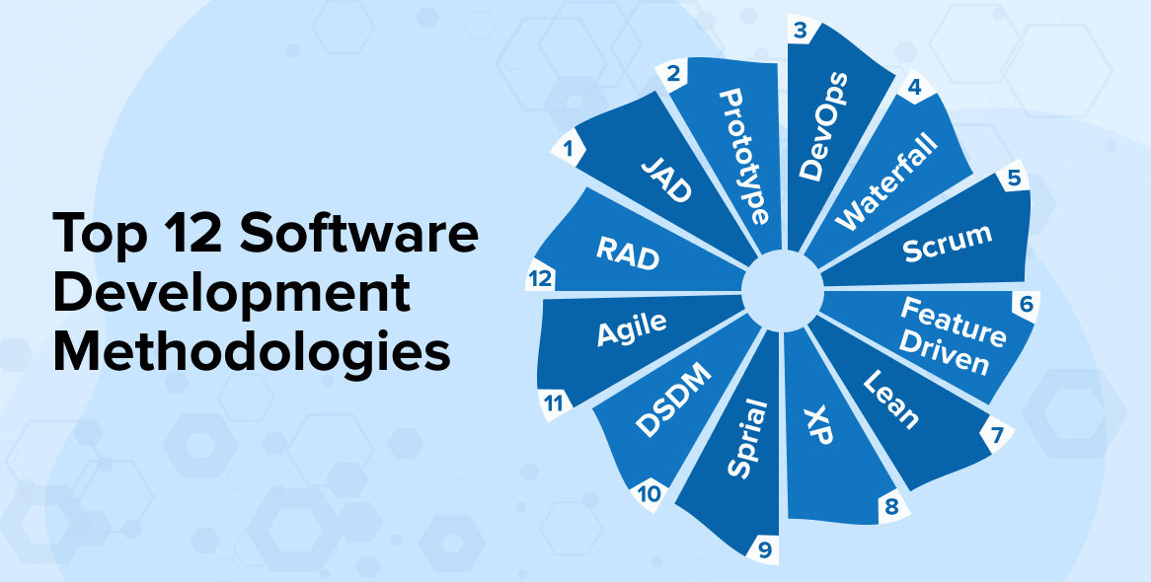
Activity - Selecting the Right Software Development Methodology
Working in teams, explore different project methodologies and apply your understanding to a real-world scenario.
What You’ll Do:
Research Agile, Waterfall, and RAD/LEAN methods
Compare their features, strengths, and limitations
Choose the most appropriate methodology for a project case
Reflect on what you’ve learned
Notes:
https://www.tatvasoft.com/blog/top-12-software-development-methodologies-and-its-advantages-disadvantages/

